Slide 1
Measuring the Centre of Data
Miss L
Year 11 Essentials

Slide 2
24
7
30
Measuring the Centre of Data
Date
EQ – How do we measure the centre of the data?
How can we better describe the data?
Sometimes its easier to compare and describe data sets if we can measure the centre of the data.
There are three statistics that are used to measure the centre of the data set:
Mode
Mean
Median

Slide 3
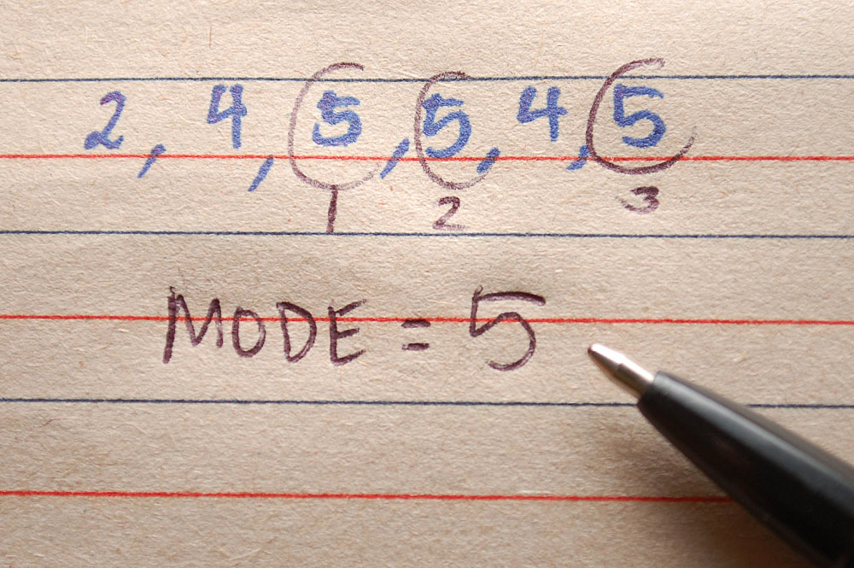
24
7
30
Measuring the Centre of Data
Date
EQ – How do we measure the centre of the data?
What is the Mode?
For discrete numerical data, the mode is the most frequently occurring value in the data set.
If a data set has two values which occurs frequently we say the data is bimodal
For continuous numerical data, we cannot talk about a mode in this way because no two data values will be exactly equal. Instead use modal class, which is the class or group that occurs the most frequently.

Slide 4
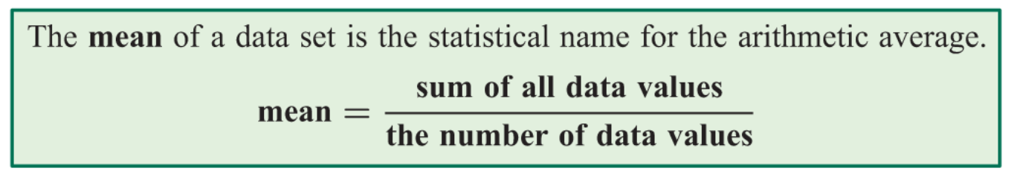
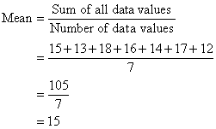
24
7
30
Measuring the Centre of Data
Date
EQ – How do we measure the centre of the data?
What is the Mean?

Slide 5
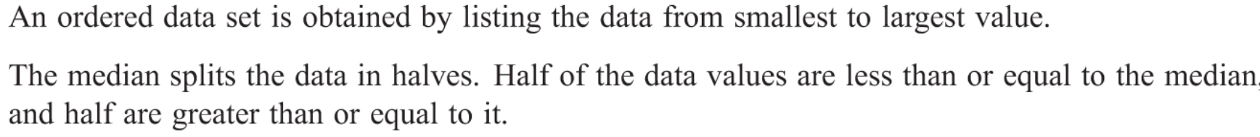
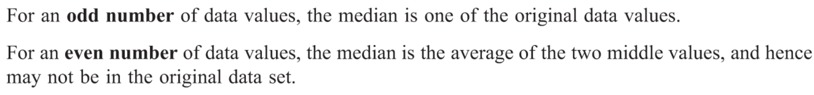
24
7
30
Measuring the Centre of Data
Date
EQ – How do we measure the centre of the data?
What is the Median?

Slide 6
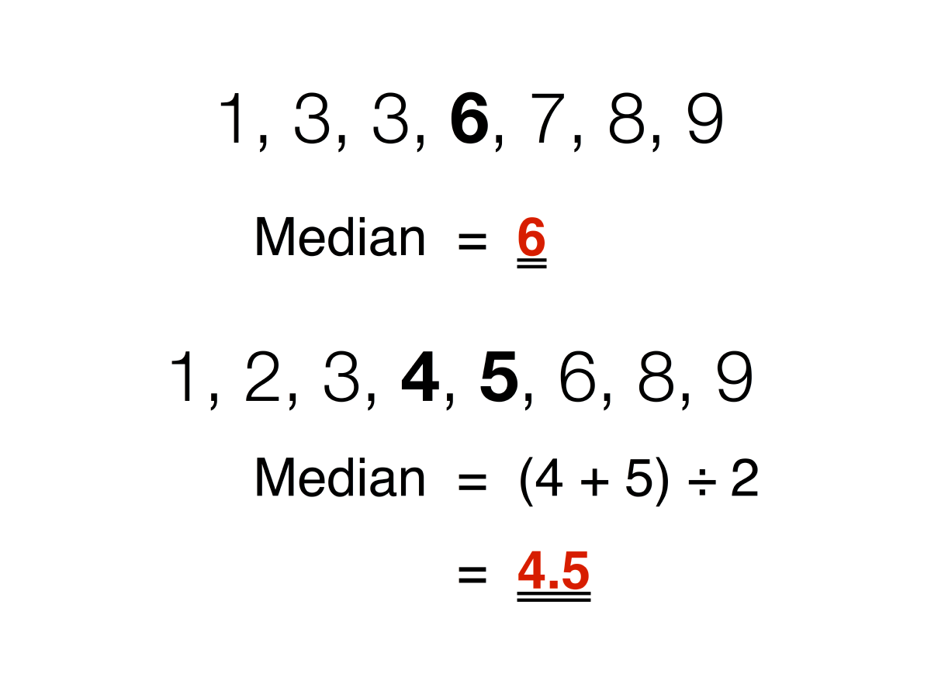

Slide 7


Slide 8
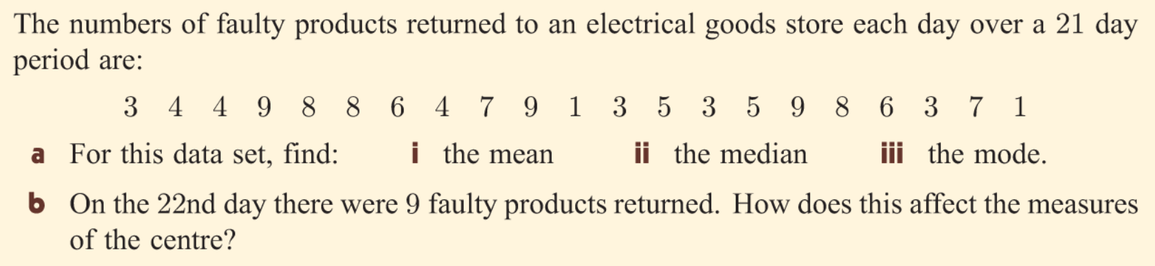

Slide 10
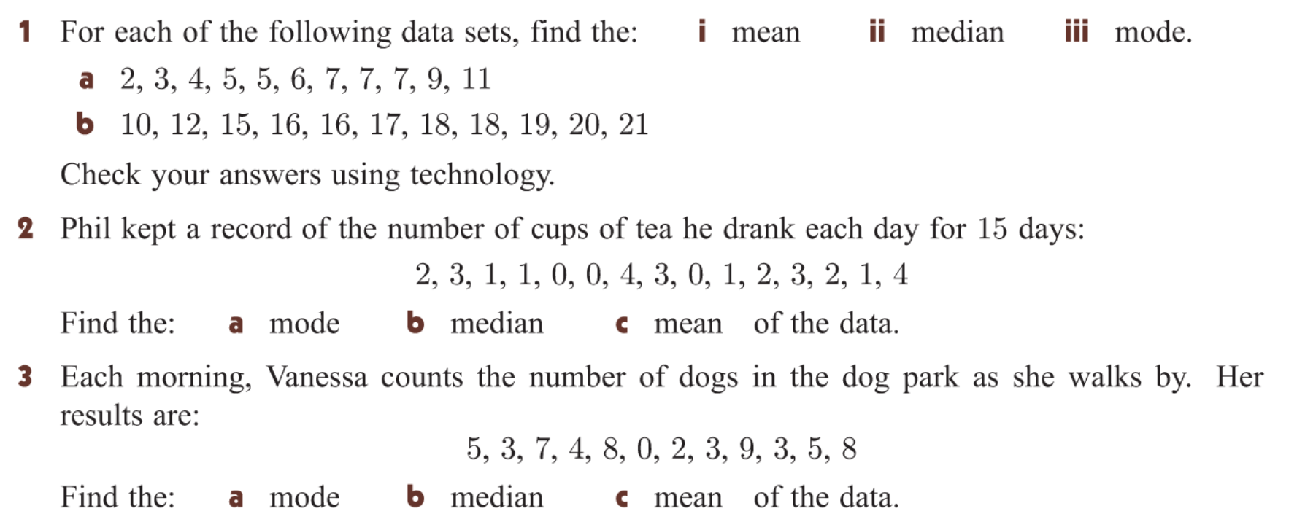
Task

Slide 11
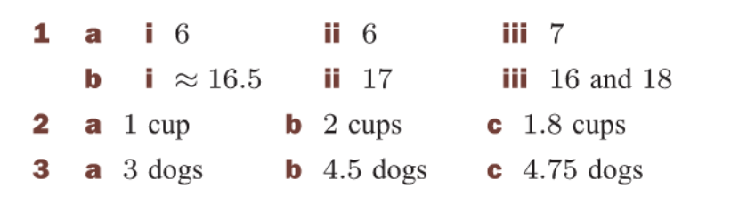

Slide 12
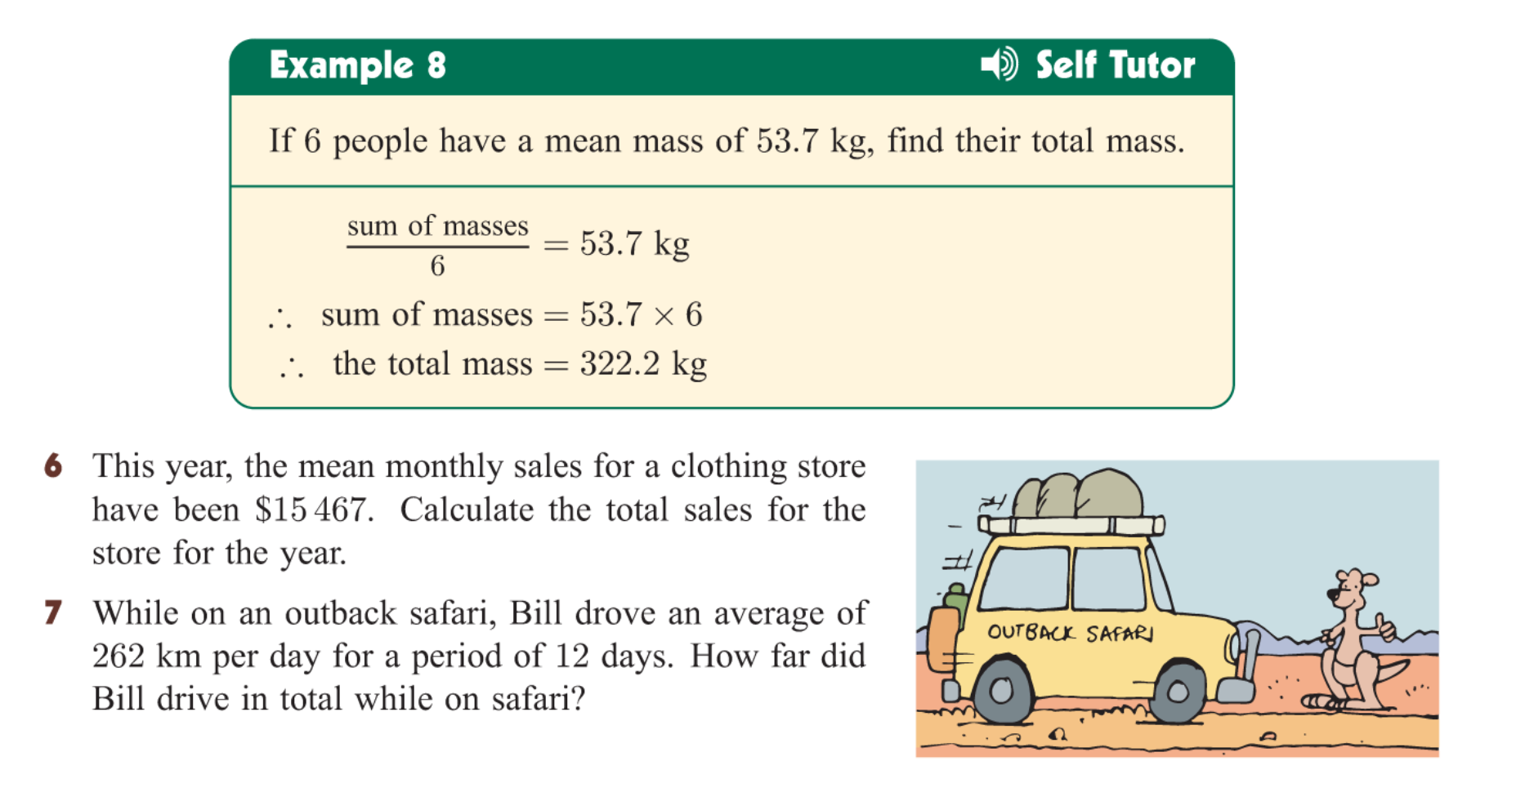

Slide 13


Slide 14
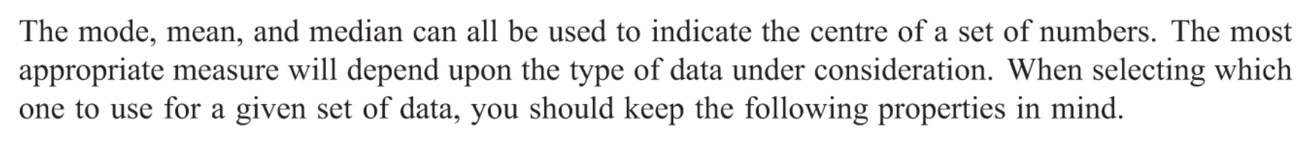
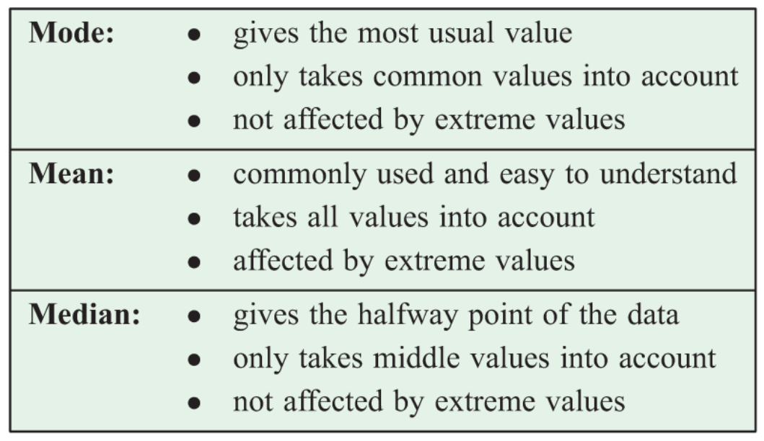
24
7
30
Measuring the Centre of Data
Date
EQ – How do we measure the centre of the data?
Choosing the correct measure of data

Slide 15
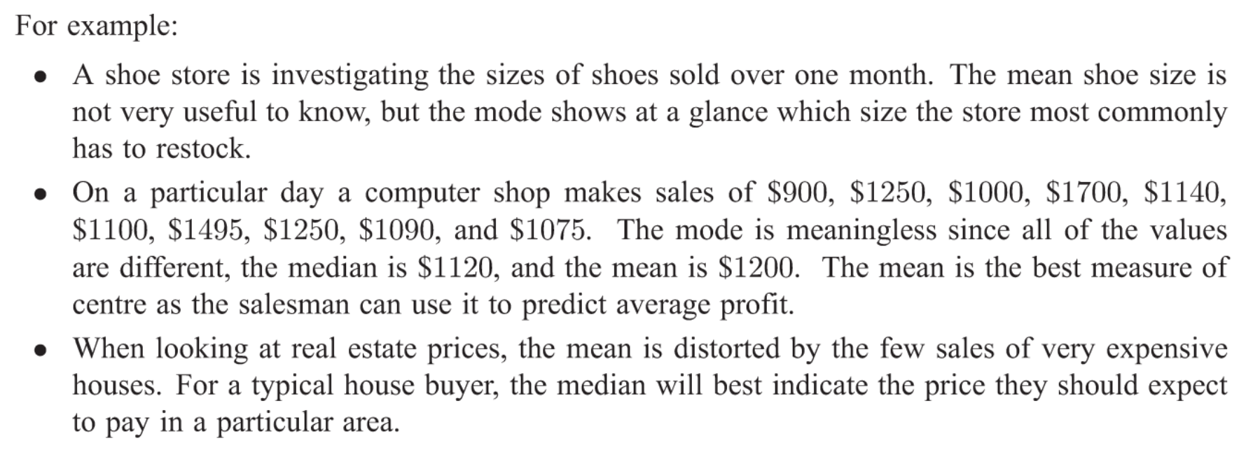

Slide 16
